Slide 1
Organic Light-Emitting Diode (OLED) With Advantages and Disadvantages
Authors Name: Pooja S Harugop
E-mail: poojaharugop@gmail.com
Co-Authors Name: Papanna B Belavi
E-mail: pbbelavi@git.edu

Slide 2
Content
Abstract
Introduction
History
What is an OLED?
Architecture of OLED
Working of OLED
Types of OLED
Advantages
Disadvantages
Applications
Conclusion

Slide 3
ABSTRACT
An Organic Light Emitting Diode (OLED) is a semiconductor device, solid in state containing a conducting and an emissive layer between two electrodes in which the emissive electroluminescent layer is a film of to create light with application of electricity.
Used in many day-to-day appliances such as portable mobile phones, handheld games, digital displays in television screens, computer monitors etc.
Since 1990s, the production of OLEDs have been one of the most promising technology due to their advantages over LCDs like high contrast ratio and wide viewing angles like 170 degrees or fast response time.

Slide 4
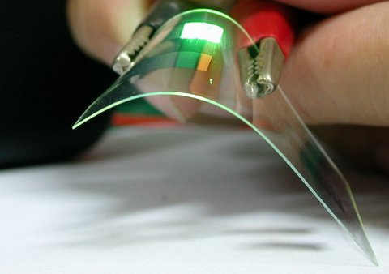
Introduction
The emission of light from materials in an electric field is called as Electroluminescence.
There are two main families of OLED those based on small molecules and those employing polymers.
An OLED display can be operated with a passive matrix (PMOLED) or active matrix (AMOLED).
An OLED display works without a backlight.
In the two layers based OLED, electrons injected from the cathode in LUMO (conduction band) and holes are injected from the anode in HOMO (valence band).

Slide 5
History
The first practical OLED’s was prepared by an American physical chemist Ching.W.Tang and Steven Van Slyke at Eastman Kodak in 1987.
In 1996, pioneer produces the world’s first commercial PMOLED.
In 2000, many companies like Motorola, LG etc developed various displays.
In 2001, Sony developed world’s largest full color OLED.
In 2002, approximately 3.5 million passive matrix OLED sub-displays were sold, and over 10 million were sold in 2003.

Slide 6
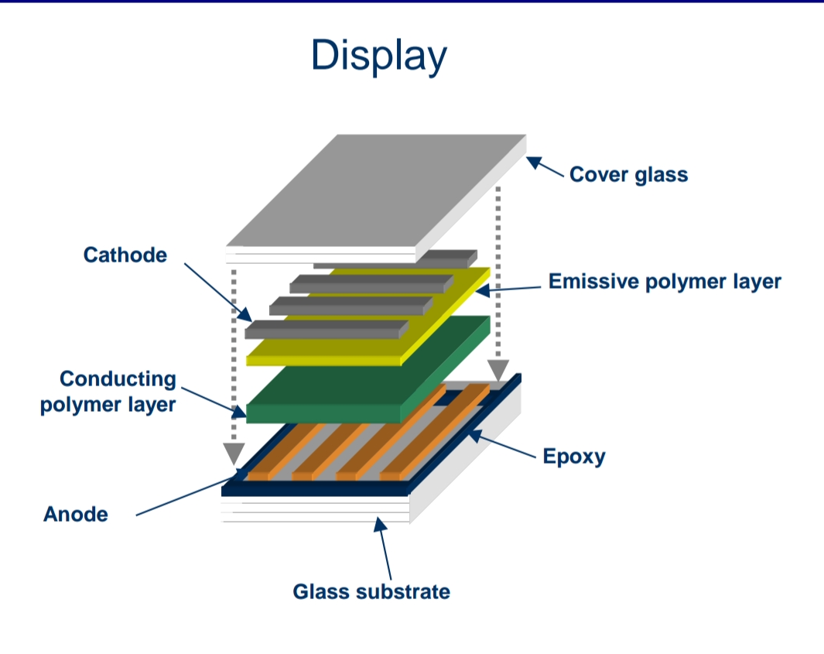
What Is An OLED?
OLED’s are solid state devices composed of thin films of organic molecules that is 100 to 500 nanometers thick.
It consists of conducting layer and an emissive layer between two electrodes and placed on a substrate.
Basically OLED’s are double charge injection devices, which require continuous supply of electrons and holes to the electroluminescent material between the electrons.

Slide 7
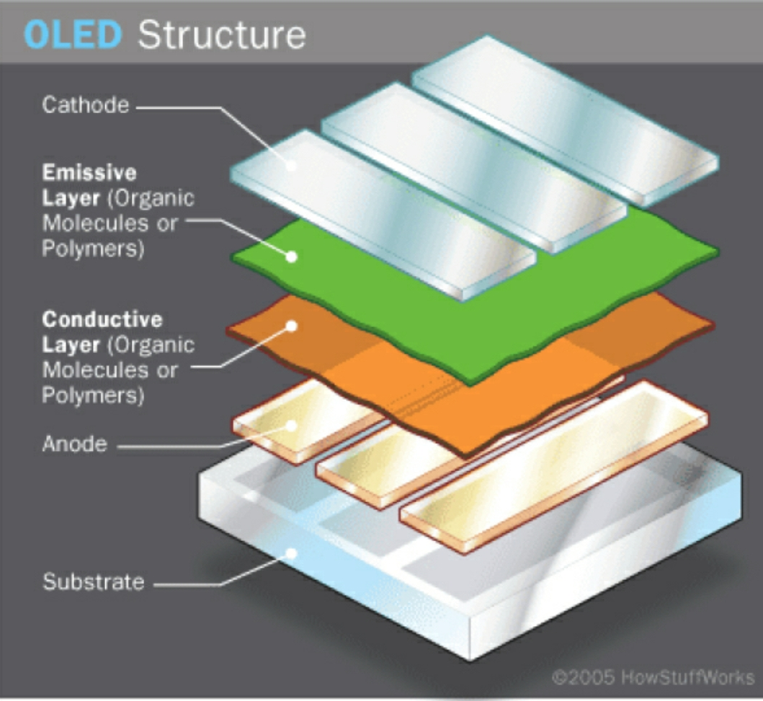
Architecture of OLED
Substrate- The substrate in an OLED may be a plastic foil or even a glass.
Anode- Indium tin oxide(ITO) is a anode component.
Cathode- Barium, calcium and aluminum are the cathode components.
Organic layer:
Emissive layer
Conductive layer

Slide 8
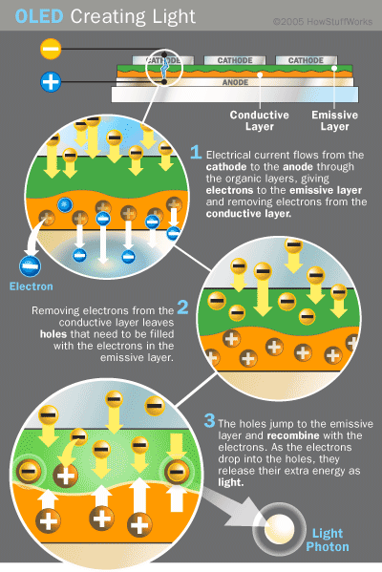
Working of OLED

Slide 9
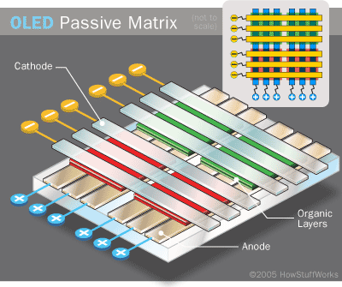
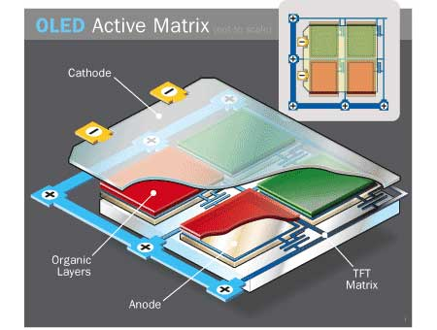
Types Of OLED’s
Passive Matrix PMOLED:-
The organic layer is in between cathode and anode which runs perpendicular.
Easy to make
Use more power
Best for small screens.
Active Matrix AMOLED:-
Full layers of cathode and anode.
Anode over lays a thin film transistor(TFT)
Requires less power
Suitable for large screens

Slide 10
Other types of OLED’s
Transparent OLEDs:- Used in rear view mirrors
Transparent projector screens
Top-emitting OLEDs:- Used in smart cards
Foldable OLEDs:- Used in Mobile phones
GPS receiver
White OLEDs:- Used in vehicles
PHOLEDs:- Used in computer monitors
TV screens Light panels

Slide 11
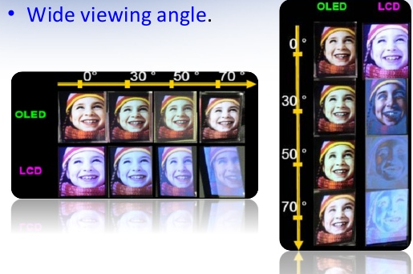
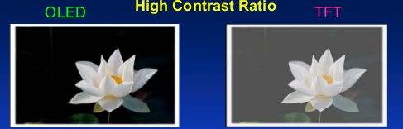
Advantages
Very thin panel of approx 1mm
Low power consumption
High brightness
High contrast ratio of 10,000:1
Wide viewing angle of 170 degree
Foldable display panel

Slide 12
Disadvantages
Lifetime
White, Red, Green : 46,000-230,000 hours
Blue : 14,000 hours
Expensive
Water damage
Power Consumption: An OLED can use more than 3 times as much power to display an image with a white background. This can lead to reduced battery life in mobile devices.
Colour Balance

Slide 13
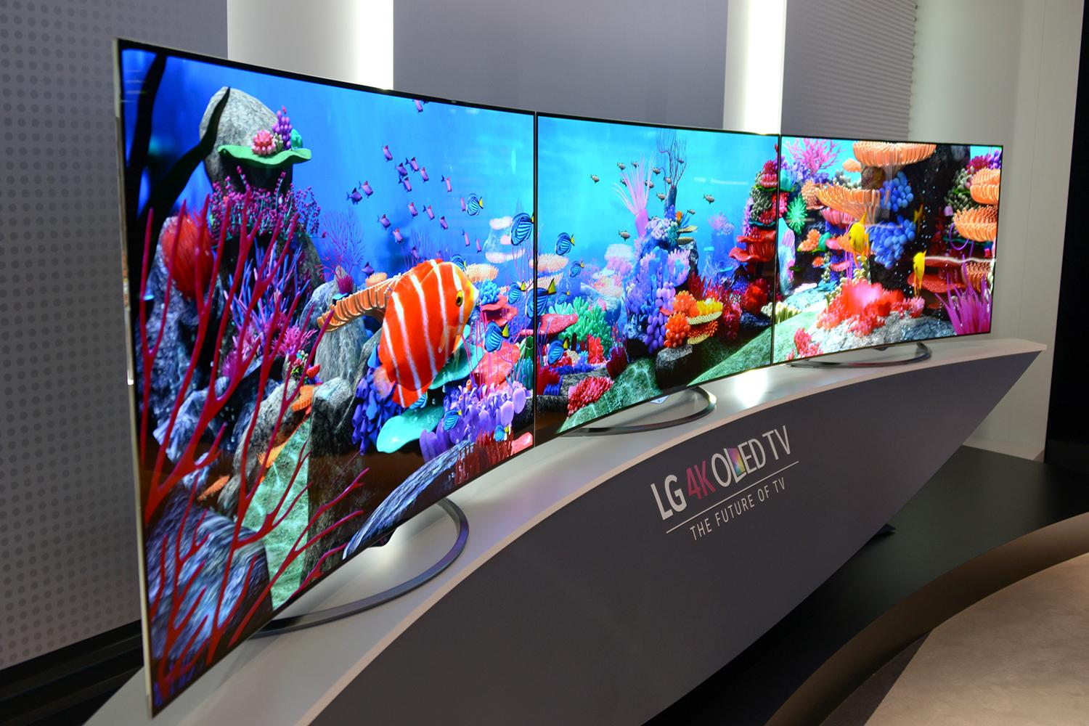
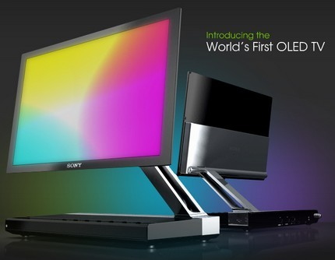
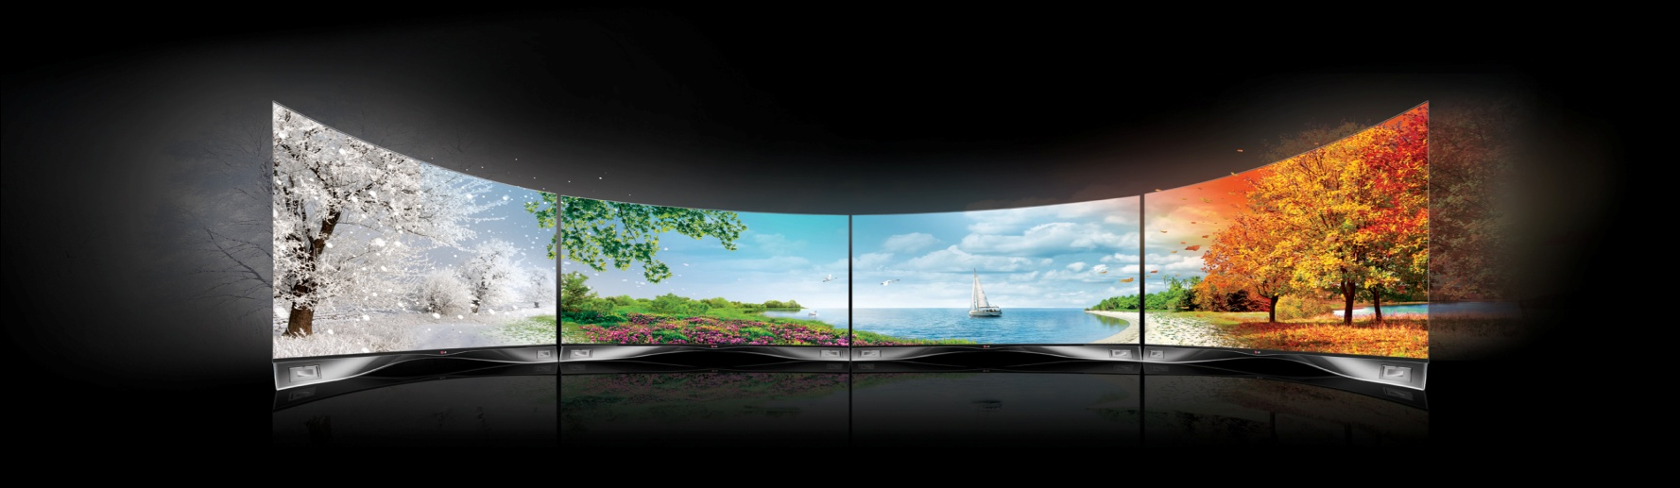
OLED TV

Slide 14
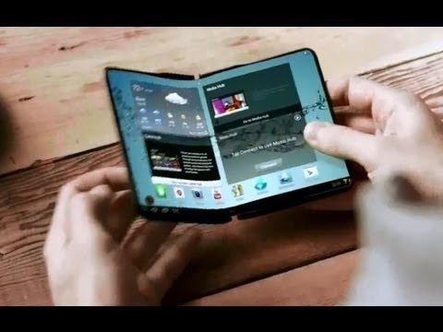
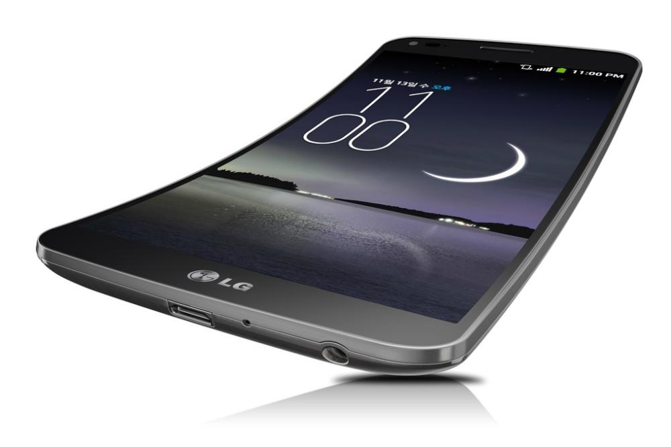
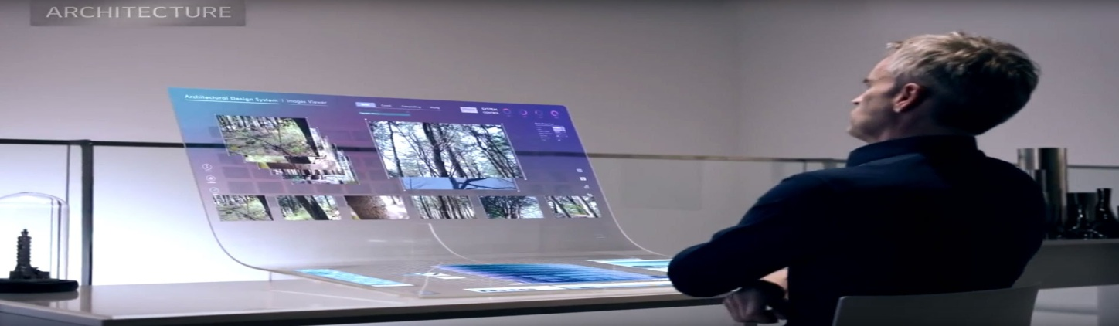
Mobile Phones with OLED Screens

Slide 15
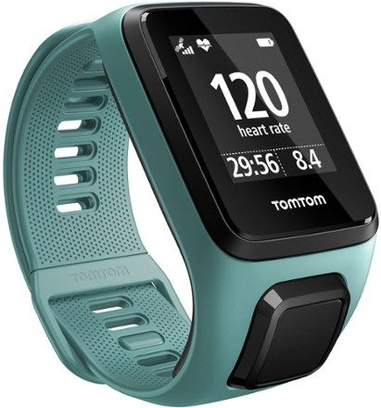
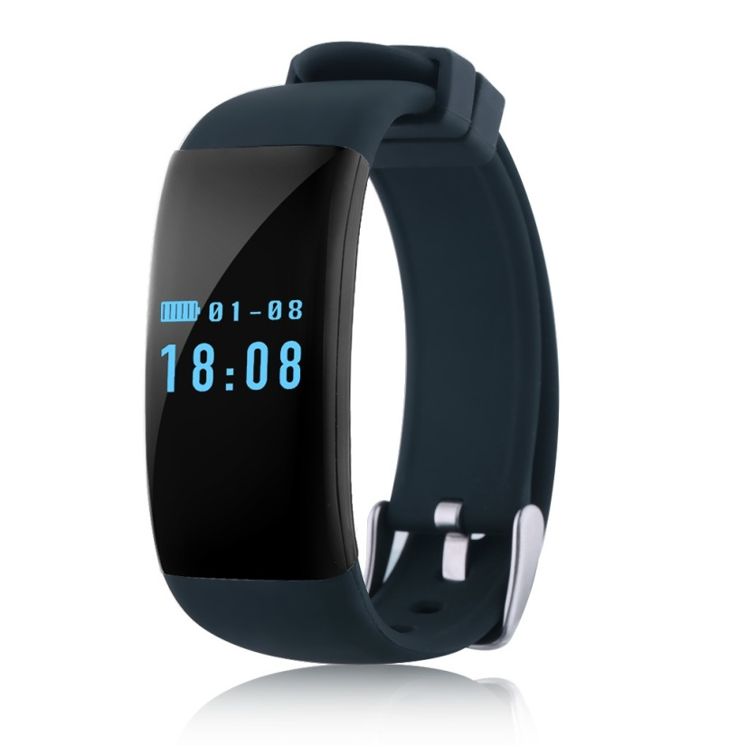
Smart Watches with OLED Display

Slide 16
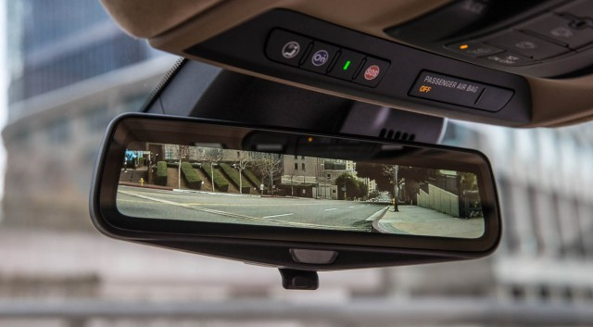
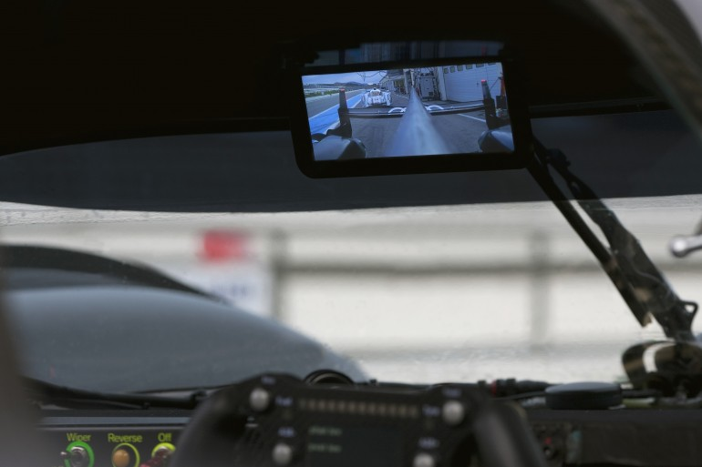
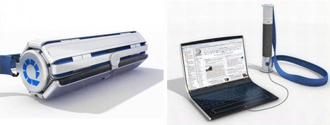
Other Applications

Slide 17
Conclusion
It is safer for the environment
It has the potential to be mass produced inexpensively
OLEDs refresh almost thousand times faster than LEDs
OLED still has many challenges like high production cost, longevity issues for colours or sensitivity to water vapour.

Slide 18


